Slide 1

NuGet
Usages & Implementation

Slide 2
How do we share dlls today?
All the dlls are stored in a particular location
All the projects add the reference to a DLL
When a DLL is updated overwrites the previous version
No Versioning all are 1.0.0.0
Or just changed with releases
Or nobody cares

Slide 3
Adding references
Find and add elmah.dll
Find and add log4net.dll
Find any other dependency
Modify configuration
Etc....

Slide 4
Binaries in src control
The binaries of the dependencies are stored in source control
In order to be able to build every time
Usually references GAC-ed assemblies

Slide 5
Update dlls nightmare
Go to each project and remove the old
Then add the new reference
Or just don’t use versioning (only internal)
But you force everyone to update!

Slide 6
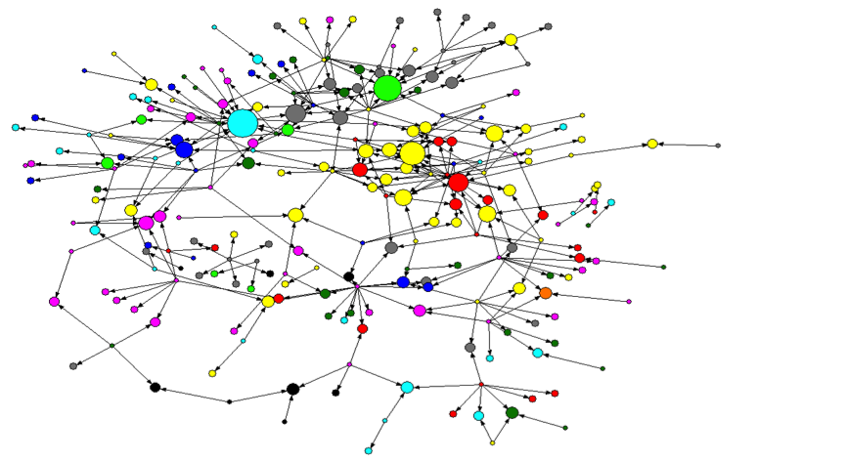
Welcome to Dependency Hell
(wikipedia):A term for the frustration of the software users who have installed software packages which have dependencies on specific versions of other software packages.

Slide 7
Cause and Effect
Reinventing the wheel
We don’t need that dependency
“If they can do it, we can do it, but better”
→ What happened to reuse of components?

Slide 8
Dependencies
Software has dependencies. Deal with it.
But are those YOUR intellectual property?
YOUR reason to build software?
YOUR product?
No. They are dependencies. And they don’t belong in source control.

Slide 9
3rd parties don’t belong in your VCS
Replace them with NuGet packages
Reduce overhead on VCS.
Get from NuGet Repository.
Have specific or latest version.

Slide 10
Problem!
NuGet feed is subject to change...
PackageSource msbuild property to the rescue
Now what...
Host your own feed and mirror packages
Or use Nexus/artifactory for that ☺ (Client specific)

Slide 11
Organize your check-ins
Feed structuring
Scoped by quality: Build, QA, Production, …
Scoped by audience: public, restricted access
Other:
Scoped by product version, milestone…
Scoped by target platform

Slide 12
Continuous Integration
Continuous Integration (CI) is a development practice that requires developers to integrate code into a shared repository several times a day. Each check-in is then verified by an automated build, allowing teams to detect problems early.
By integrating regularly, you can detect errors quickly, and locate them more easily.

Slide 13
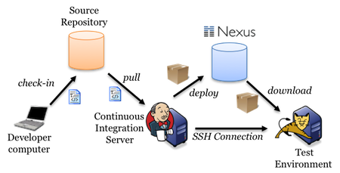

A typical CI pipeline
Some Repository system
NuGet
Versions Dlls

Slide 14
What is NuGet
NuGet is the package manager solution for the Microsoft development platform.
Intended to solve the issues related to management of 3rd party assembly dependencies
Packages are zip archives
Originally .NET, now anything
Discovery, packages, dependencies, updates
NuGet client tools provide the ability to produce and consume packages.
NuGet Gallery is a central package repository used by all package authors and consumers.

Slide 15
.NET is late to the party!
Others have been doing package management for decades
Perl (CPAN.org)
Linux (RPM/YUM/APT-GET/...)
PHP (PEAR, Composer)
Node (npm)
Ruby (Gems)
We can learn a great deal from these!

Slide 16
Supporting componentization
Every project is a package
Clearly identifyable
Proper Semantic Versioning
Every project becomes discoverable
Nice description, release notes, ...
Add it to a private feed so developers can find it
Dependencies (can) stay out of source control
Dependencies are versioned

Slide 17
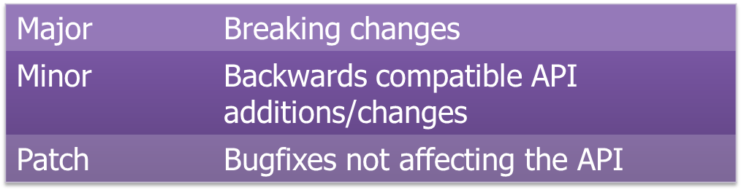
Semantic Versioning
Think about your versioning! {semver.org}
Always specify lowerbound
Use a version range {lowerbound + upperbound} when versioning of package you depend on is messed up

Slide 18
Guidance
Publishing a package brings great responsibility
Breaking changes in your packages should be versioned accordingly!
Consumers might choose to no longer consume any packages you published

Slide 19
Guidance
Package Integration & Integration Testing
CI builds reflect output of source control input
Same input always produces same output
➔ Do not auto-update packages during automated builds

Slide 20
NuGet Components
Gallery Server
NuGet Core
VS Addin
MsBuild Tasks
C#
WCF Data Services
C#
Console App
Package Explorer

Slide 21
Components
NuSpec
Xml file containing the specification to be packaged
NuPkg
Zip file containing the package contents, [un]install scripts, and NuSpec
NuGet Gallery
Hosted website to serve up latest or specific versions of packages (NuPkg)
NuGet VS Extension
Visual Studio Plugin to allow installation of packages
Nuget.exe
Command line application for installing packages and managing gallery

Slide 22
NuSpec File
<?xml version="1.0"?>
<package >
<metadata>
<id>Package</id>
<version>1.0.0</version>
<authors>jhoonjhar.jodha</authors>
<owners>jhoonjhar.jodha</owners>
<licenseUrl>http://LICENSE_URL_HERE_OR_DELETE_THIS_LINE</licenseUrl>
<projectUrl>http://PROJECT_URL_HERE_OR_DELETE_THIS_LINE</projectUrl>
<iconUrl>http://ICON_URL_HERE_OR_DELETE_THIS_LINE</iconUrl>
<requireLicenseAcceptance>false</requireLicenseAcceptance>
<description>Package description</description>
<releaseNotes>Summary of changes made in this release of the package.</releaseNotes>
<copyright>Copyright 2016</copyright>
<tags>Tag1 Tag2</tags>
<dependencies>
<dependency id="SampleDependency" version="1.0" />
</dependencies>
</metadata>
</package>

Slide 23
Packages
A package is a bundle of something you want to reuse.
It can have dependencies to other packages.
It can contain files:
Assemblies
Content
Tools

Slide 24
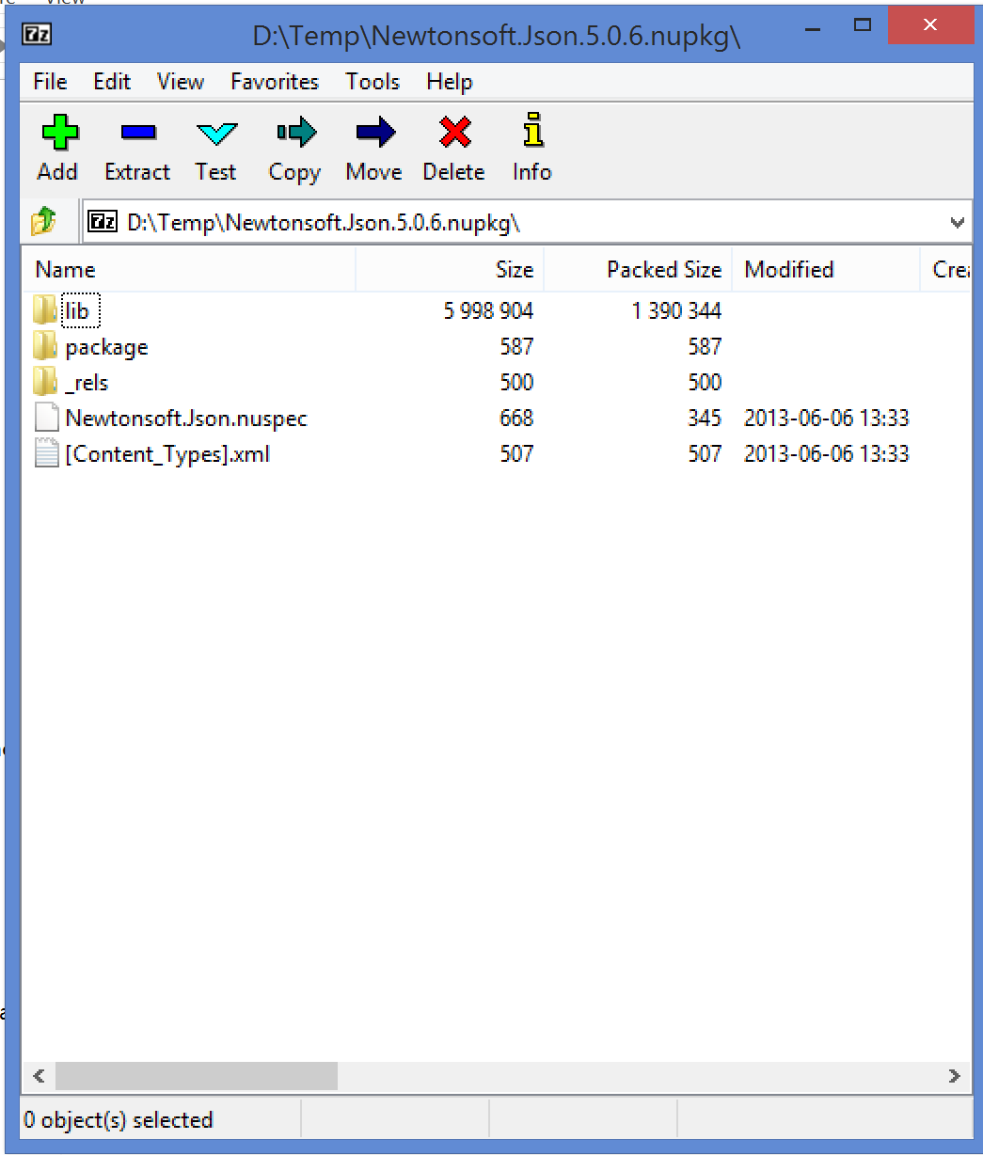
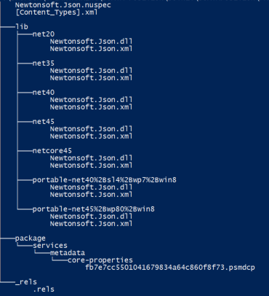
NuPkg File

Slide 25
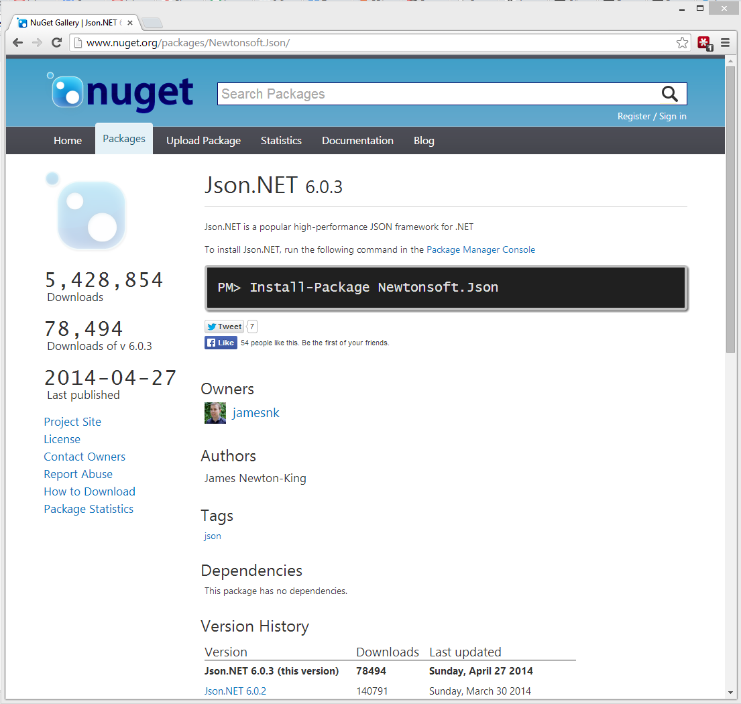
Gallery
The public gallery is good for openly shared code.
You can also host private galleries and configure them locally.
NuGet will check both locations for referenced packages…
Private can be done:
Local folder based
Small version (no DB)
Full version (requires DB)
Service (like MyGet)

Slide 26
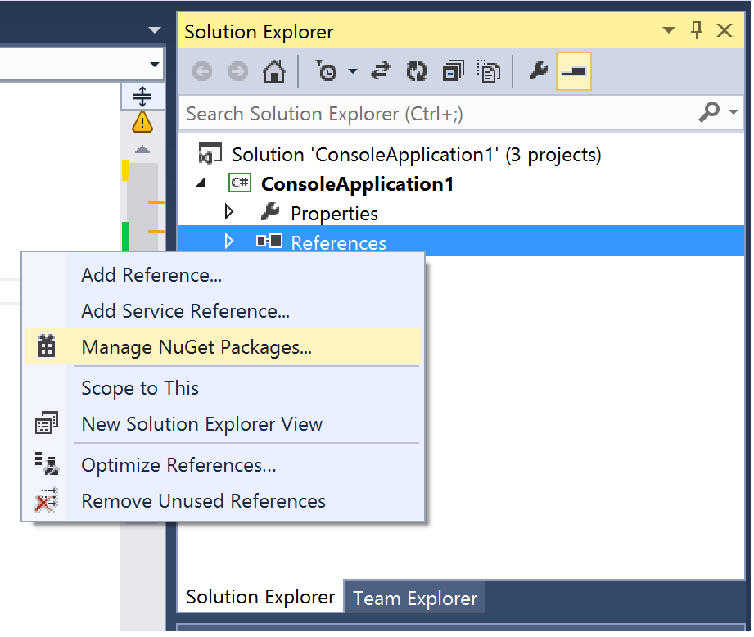
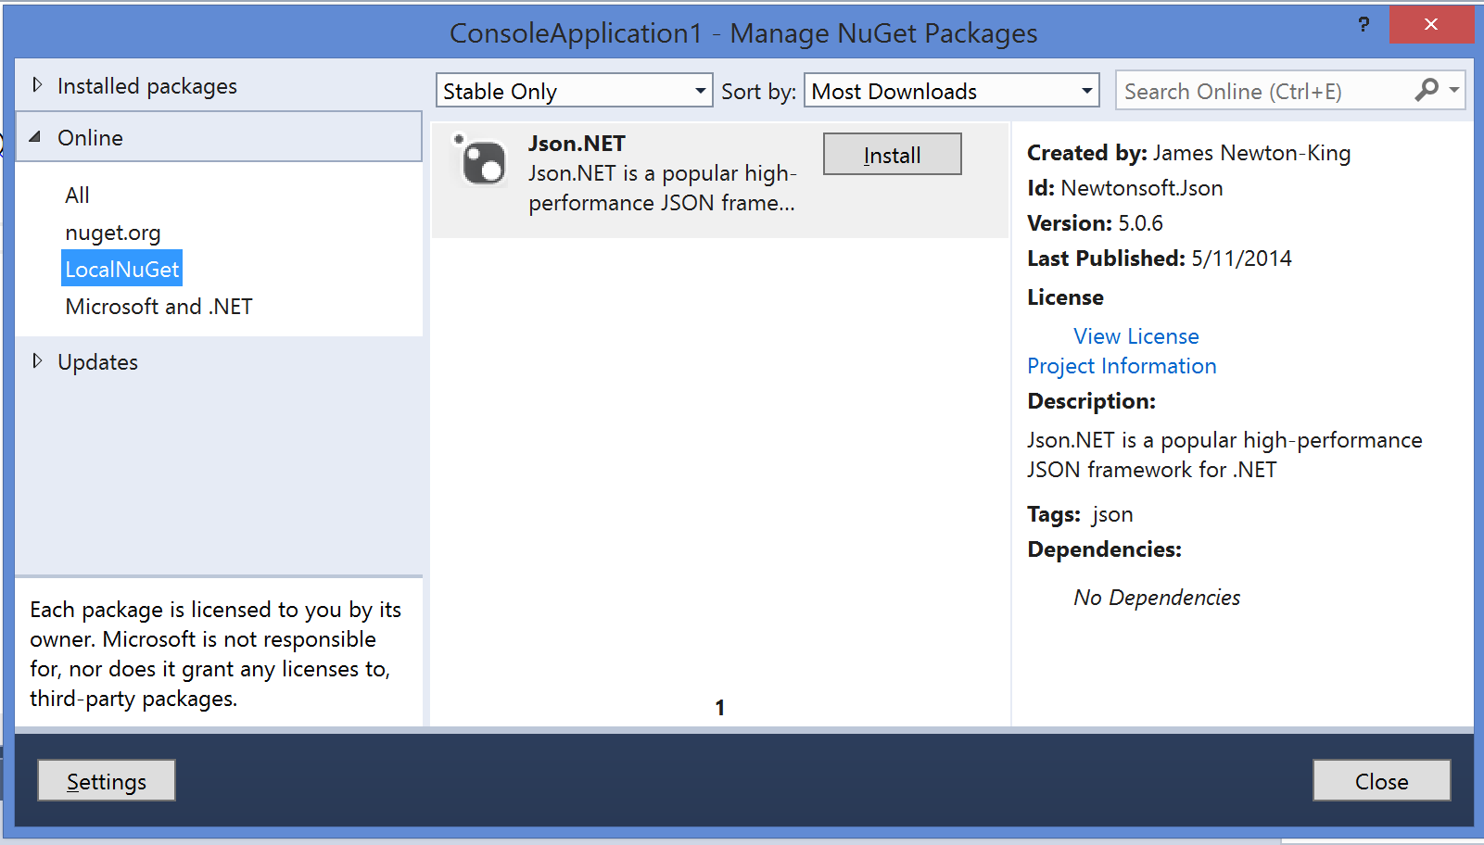
Visual Studio Integration (GUI - Nav)

Slide 27
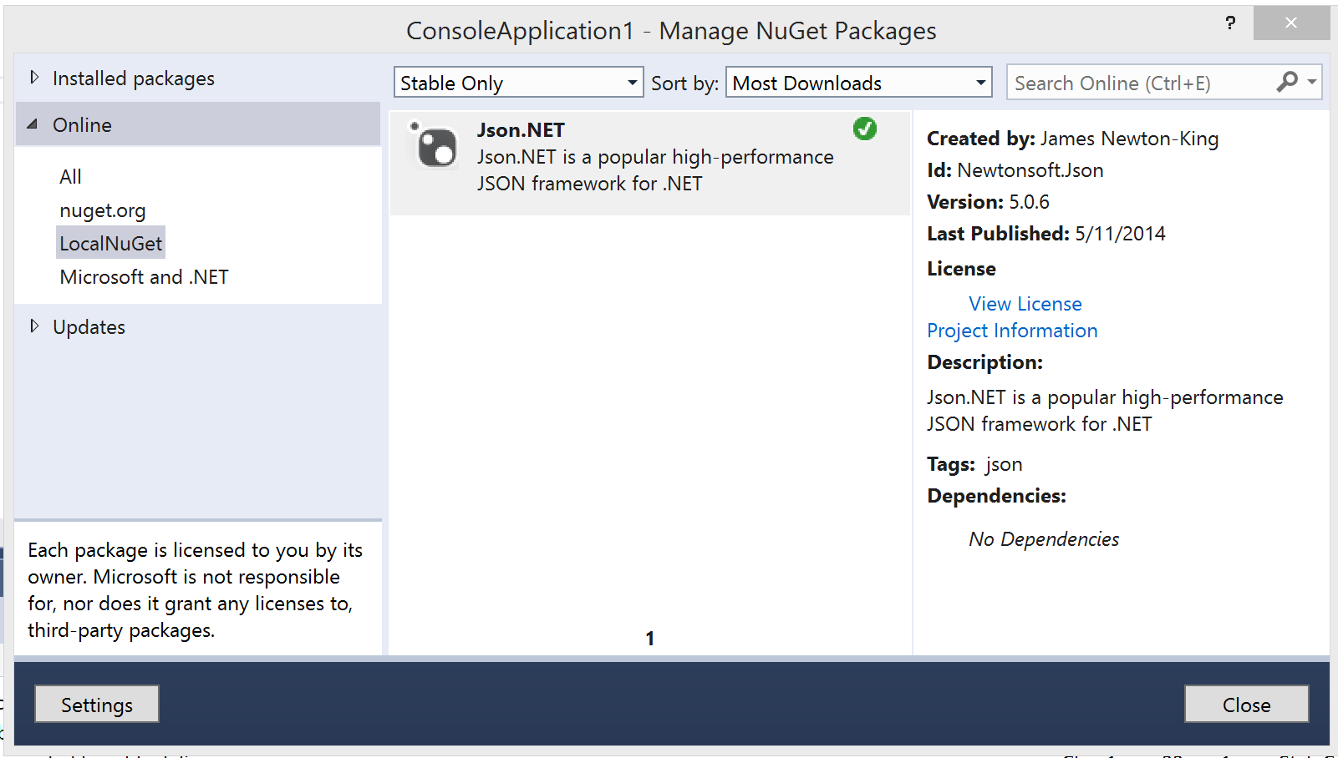
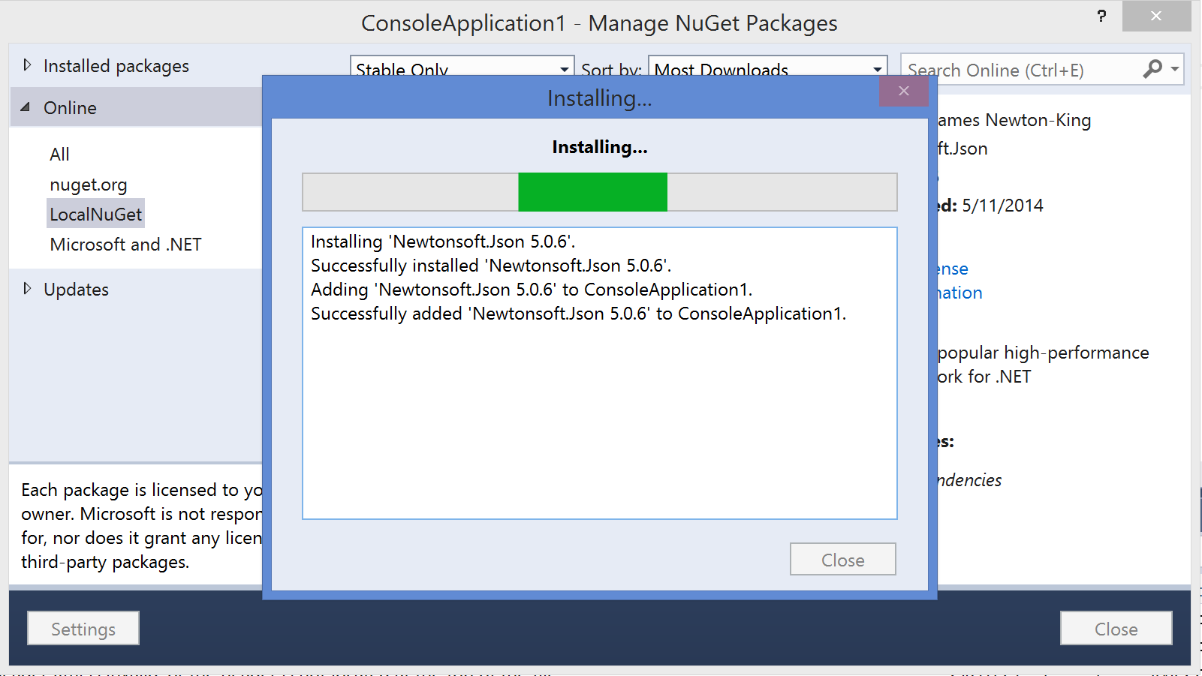
Visual Studio Integration (GUI - Install)

Slide 28
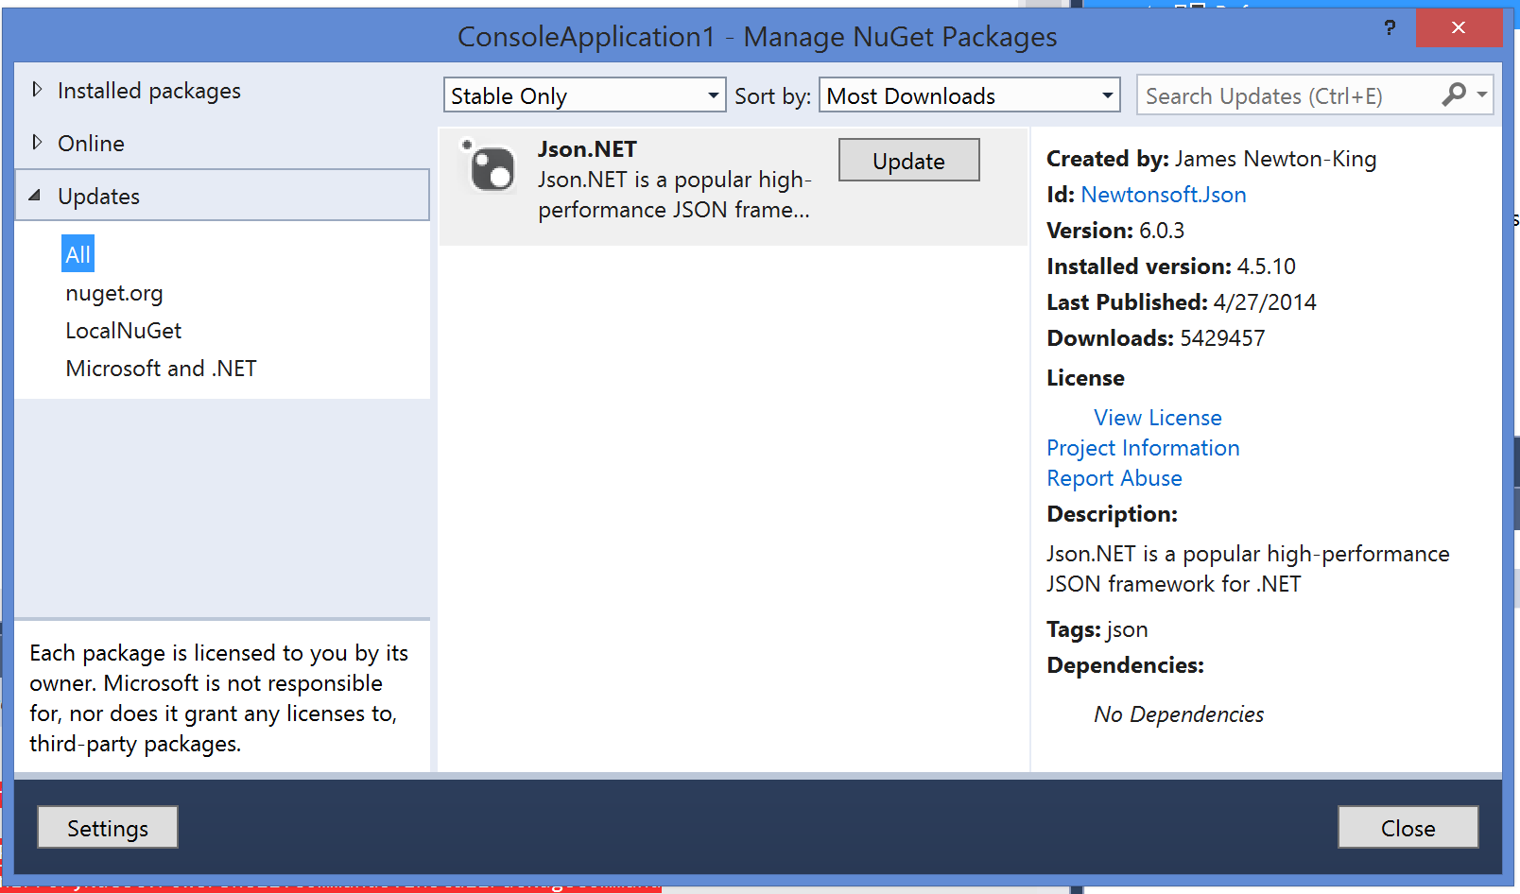
Visual Studio Integration (GUI - Update)

Slide 29
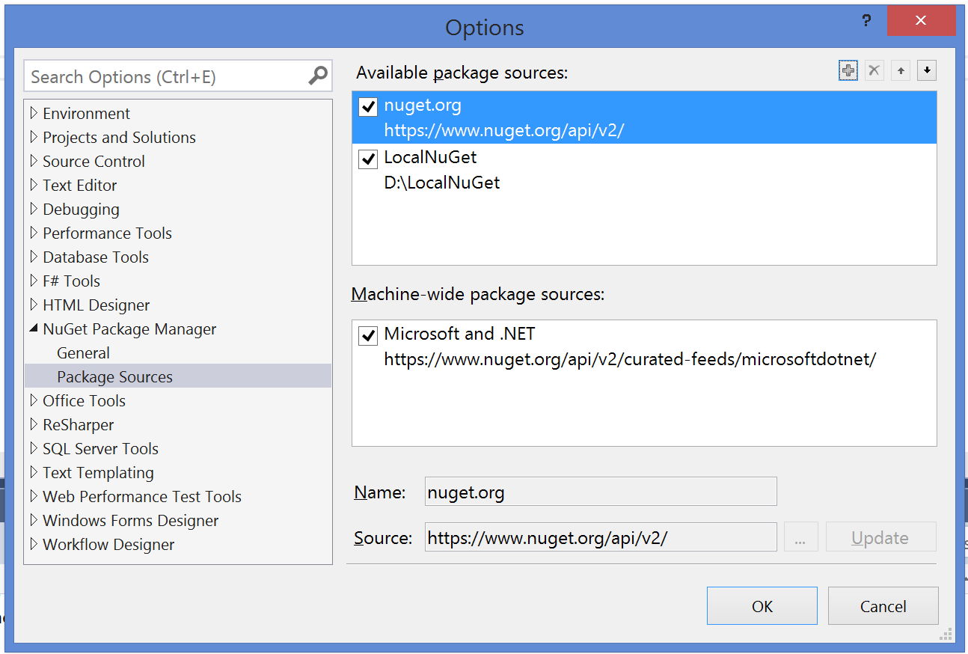
Visual Studio Integration (GUI - Settings)

Slide 30
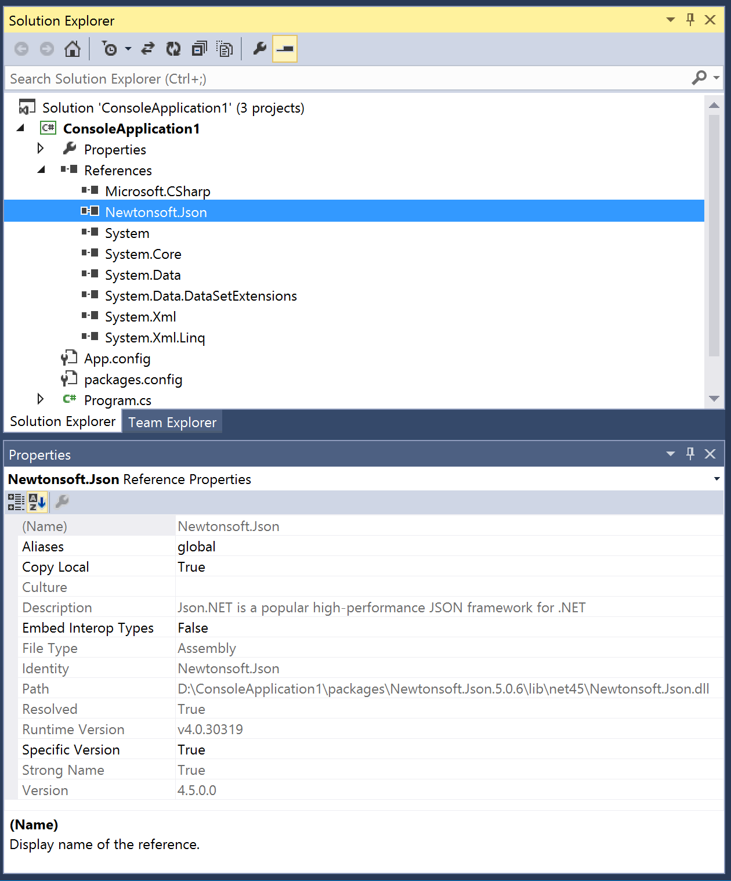
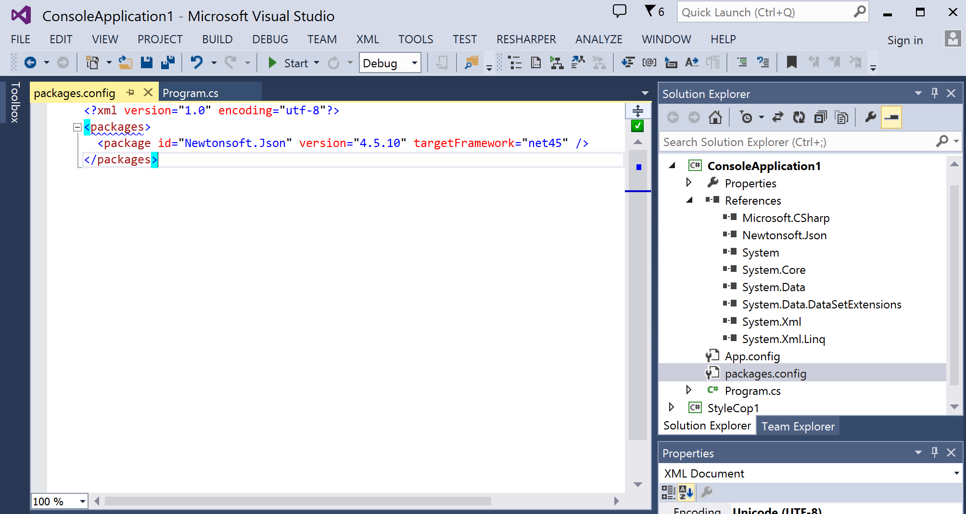
Visual Studio Integration (GUI - References)

Slide 31

When you add a library or tool, NuGet copies files to your solution and automatically makes whatever changes are needed in your project, such as adding references and changing your configuration files
When you remove a library, NuGet removes files and reverses whatever changes it made in your project so that no clutter is left.

Slide 32
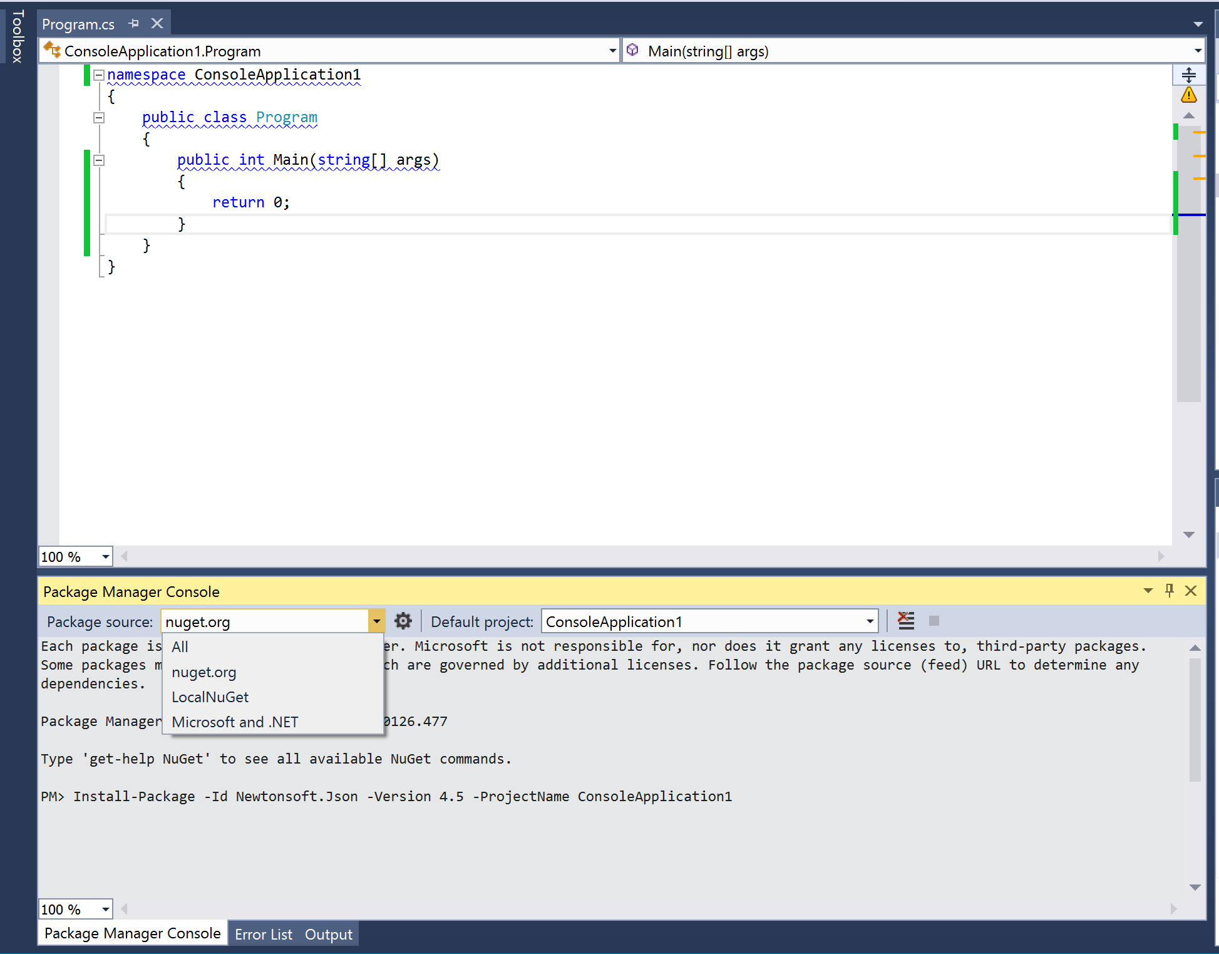
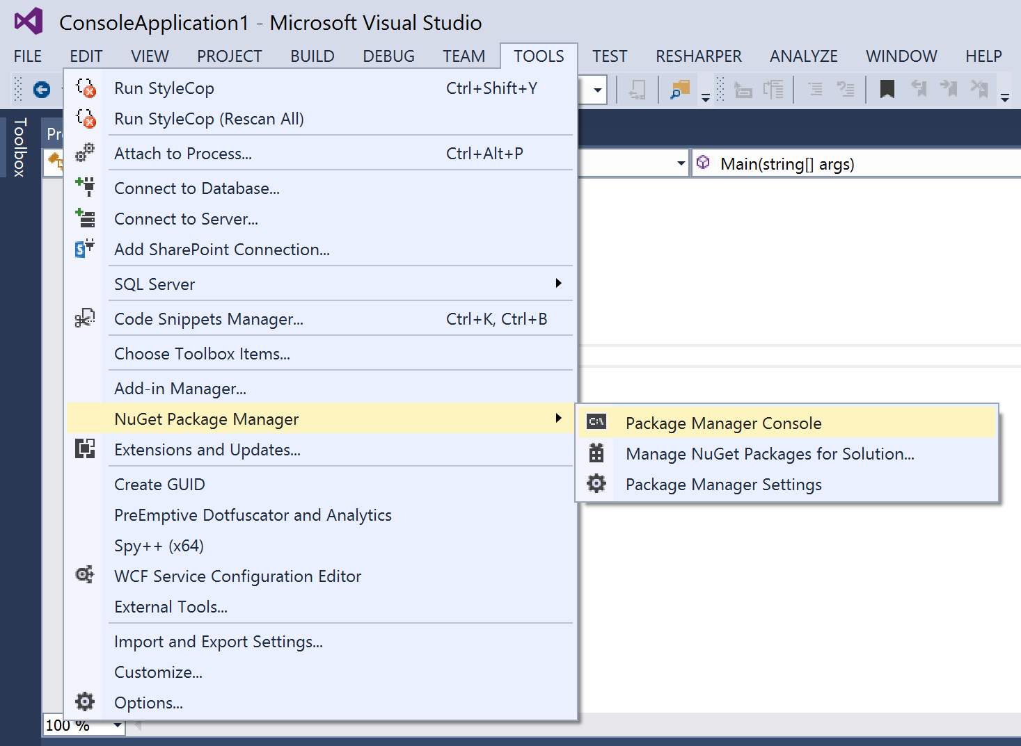
VS (Package Management Console)
Powershell with some loaded modules.
Allows specific version installation as well as uninstall.

Slide 33
NuGet.exe (command line interface)
nuget.exe help [feature (i.e. pack)]
Help lists commands and can be combined with a command to get info
nuget.exe pack [PackageID].nuspec –version 1.1.0.0
First the NuSpec is used to construct the package file via the ‘pack’ stage
nuget.exe push [PackageID].nupkg [API Key] –Source [Gallery]
Next the created NuPkg is loaded into the appropriate gallery via the ‘push’ stage
nuget.exe install [packages.config file OR package id]
When packages are in the gallery you can install them locally
nuget.exe update [solution file OR project file]
When packages are in the gallery you can update to latest version

Slide 34
Development Best Practices
Understand semantic versioning
Develop components in isolation
Careful interface design and versioning
Unit test at least every public method
Document all public symbols

Slide 35
DevOps Considerations
Automate push on release and documentation
Automate labelling for traceability
Source/symbol serving is your friend
Version all the things! (if you wish)

Slide 36
Issues with Nuget.org
NuGet = public feed
No Privacy
Intellectual property
NuGet maintained by package authors
Author removes v1.0.45 and you depend on it
Bracking changes can impact your business.
Spying threat / Information leaks

Slide 37
Solutions
Folder / File share
NuGet.Server package
NuGet Gallery {or Orchard Gallery}
MyGet
Or third party pakcage mangement solutions placed in enterprises (we are using Nexus/artifactory).

Slide 38
Demo

Slide 39
Where do I get it?
VS Addin: NuGet Package Manager
http://visualstudiogallery.msdn.microsoft.com/en-us/27077b70-9dad-4c64-adcf-c7cf6bc9970c
Console App
http://nuget.codeplex.com/
MsBuild Tasks
http://nuget.codeplex.com/
NuGet Explorer
http://nuget.codeplex.com/
Gallery Server
http://galleryserver.codeplex.com/

Slide 40
Thank you
Share your feedback on meeting note.

